Slide 1
TYPES OF RADAR SYSTEMS
Presented by : Tasmia Nazakat

Slide 2
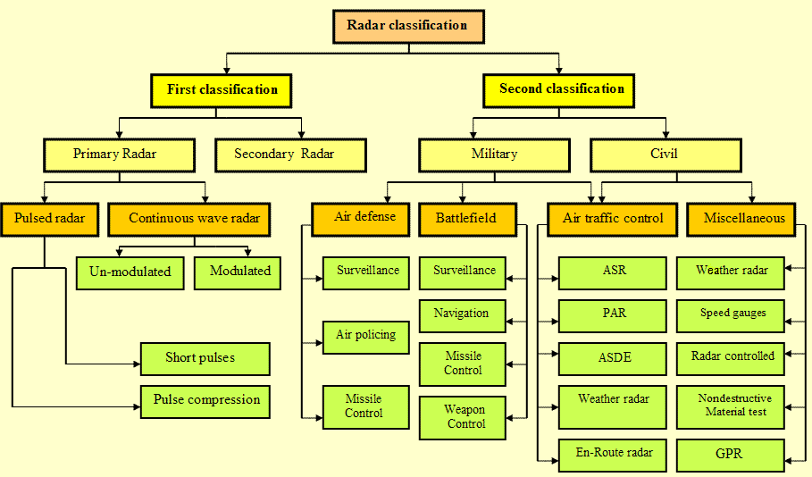
CLASSIFICATION TREE

Slide 3
LOCATION OF TRANSMITTER
Monostatic radar : Both transmitter and receiver in the same location.
Bistatic radar : The transmitter and receiver are placed in different locations.
Multistatic radar : There are one transmitter and several receivers placed in different locations.

Slide 4
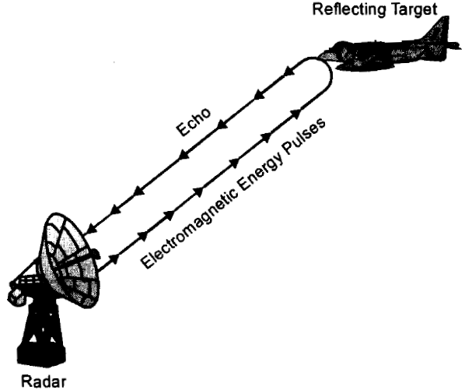
1. PRIMARY RADAR
This relies on the reflection of a portion of the incident energy by the target.
The target does not willingly co-operate with the radar installation.
This is the type of radar used to detect and track hostile aircraft.

Slide 5
2. SECONDARY RADAR
The radar installation and the target help each other.
The signal received at the radar installation is not a reflection of the incident energy .
An example of secondary radar is the identification equipment carried by all friendly ships and aircraft.

Slide 6
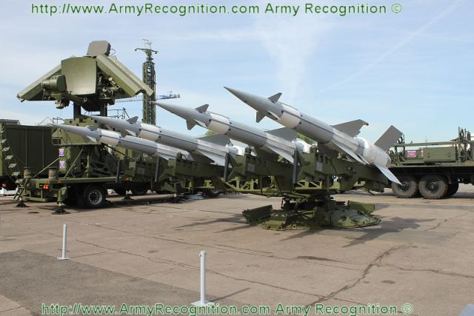
3. MILITARY RADAR TYPES
Military radars are divided into three Categories:
    Air Defense Radar
    Battlefield Radar
    Air Traffic Control Radar

Slide 7
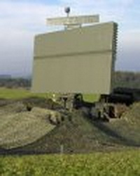
AIR DEFENSE RADARS (1)
Air defense radars can detect air targets and determine their position, course, and speed in a relatively large area.
The maximum range of air defense radar can exceed 500 Kms, and the bearing coverage is a complete 360 degree circle.

Slide 8
AIR DEFENSE RADARS (2)
Functions of Air Defense Radars are:
To serve as Early Warning systems because they can detect approaching enemy aircraft at great distances.
To Police the National Airspace.
To Guide combat Air Patrol Aircraft to a position suitable to intercept an enemy aircraft.
To defend against aircraft.

Slide 9
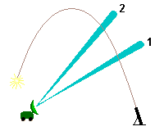
BATTLEFIELD RADARS
Battlefield radar was divided into three types:
Surveillance: to alert combat troops of hostile and unknown aircraft, cruise missiles and unmanned aerial vehicles
Navigation: for fixing a vessel´s position with sufficient accuracy to allow safe passage
Weapon control: by providing information used to guide weapons to a hostile target

Slide 10
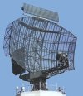
AIR TRAFFIC CONTROL RADARS
Air traffic control radar was divided into five types:
Airport Surveillance Radar (ASR)
(b) Precision Approach Radar (PAR).
(c) Surface Movement Radar (SMR)
(d) weather radar
(e) En-route radar

Slide 11

CIVILIAN APPLICATIONS OF RADAR
Weather Radar
Speed device.
Radar Control
Non-Destructive Material Test
Ground Penetrating Radar (GPR)

Slide 12


